Slide 1
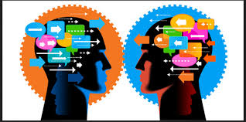
Communication Skills
By:
Mr. Mukesh Mahay

Slide 2
Topics
Communication skills
Types of communication and 7 C’s
Importance of communication

Slide 3
Let’s communicate
Communication is the activity of conveying information. The word communication has been derived from the Latin word ‘communis’, meaning to share. It involves a sender, a message and a receiver.
Sender
Can be one or more
Message
Can be simple or complex
Receiver
Can be one or more

Slide 4

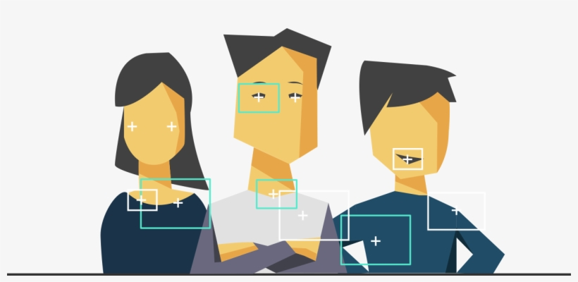
Types of communication skills
Verbal – Verbal communication refers to the use of sounds and language to relay a message.
Non Verbal – Nonverbal communication (NVC) between people is communication through sending and receiving wordless clues.

Slide 5
Elements of verbal communication
Volume
Clarity in speech, thoughts, knowledge , Fluency
Grammar, vocabulary
Accent
Avoid Fillers ,Focus on Voice Modulation(Pitch, Tone)
Be confidence
Rate of speech
Content
Confidence

Slide 6



Activity: What to do/ what not to do

Slide 7
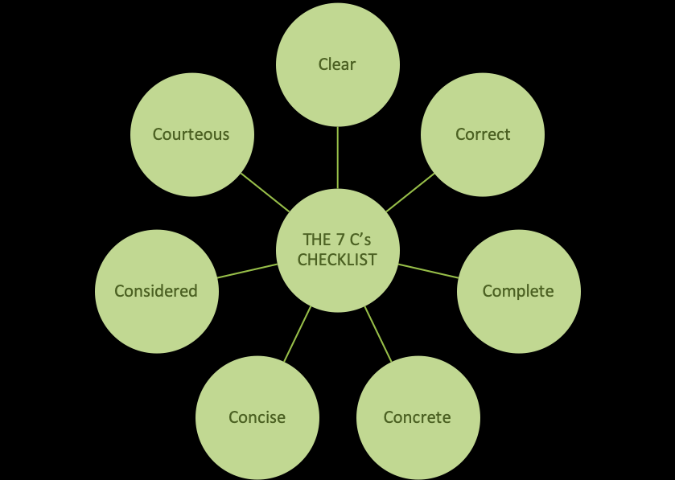
7 C’s in Verbal communication skills

Slide 8
Non Verbal communication skills
Facial expressions
The human face is extremely expressive, able to express countless emotions without saying a word.
Body movements and posture
Consider how your perceptions of people are affected by the way they sit, walk, stand, or hold their head.
Gestures
Gestures are woven into the fabric of our daily lives. We wave, point, beckon, and use our hands when we’re arguing or speaking .
Eye contact
Since the visual sense is dominant for most people, eye contact is an especially important type of nonverbal communication.
Touch
We communicate a great deal through touch. Think about the messages given by the following: a weak handshake, a timid tap on the shoulder.
Space
Have you ever felt uncomfortable during a conversation because the other person was standing too close and invading your space? Proximity.
PARAVERBAL- Your TONE, PITCH, STRENGTH OF SPEED

Slide 9
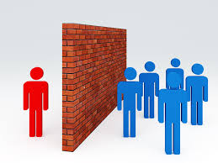
Effective Communication skills- Importance
Building trust
Preventing or resolving problems
Increases engagement
Creates better relationships
Promotes team building
Improves productivity
Personality development
NOTE: Read English newspapers , listen to English news like BBC to improve communication

Slide 10
Barriers in communication skills
Linguistic Barriers
Psychological Barriers
Emotional Barriers
Physical Barriers to Communication
Physiological Barriers
Technological Barriers( like in google meet , camera quality , internet)

Slide 11

Notes:
Thank you and see you soon!

